Slide 1
Hardware and Software Platforms in Mechatronics and Robotics Engineering Education
Unified Curriculum and Course Design for Mechatronics and Robotics Engineering Workshop
5-7 January 2022

Slide 2
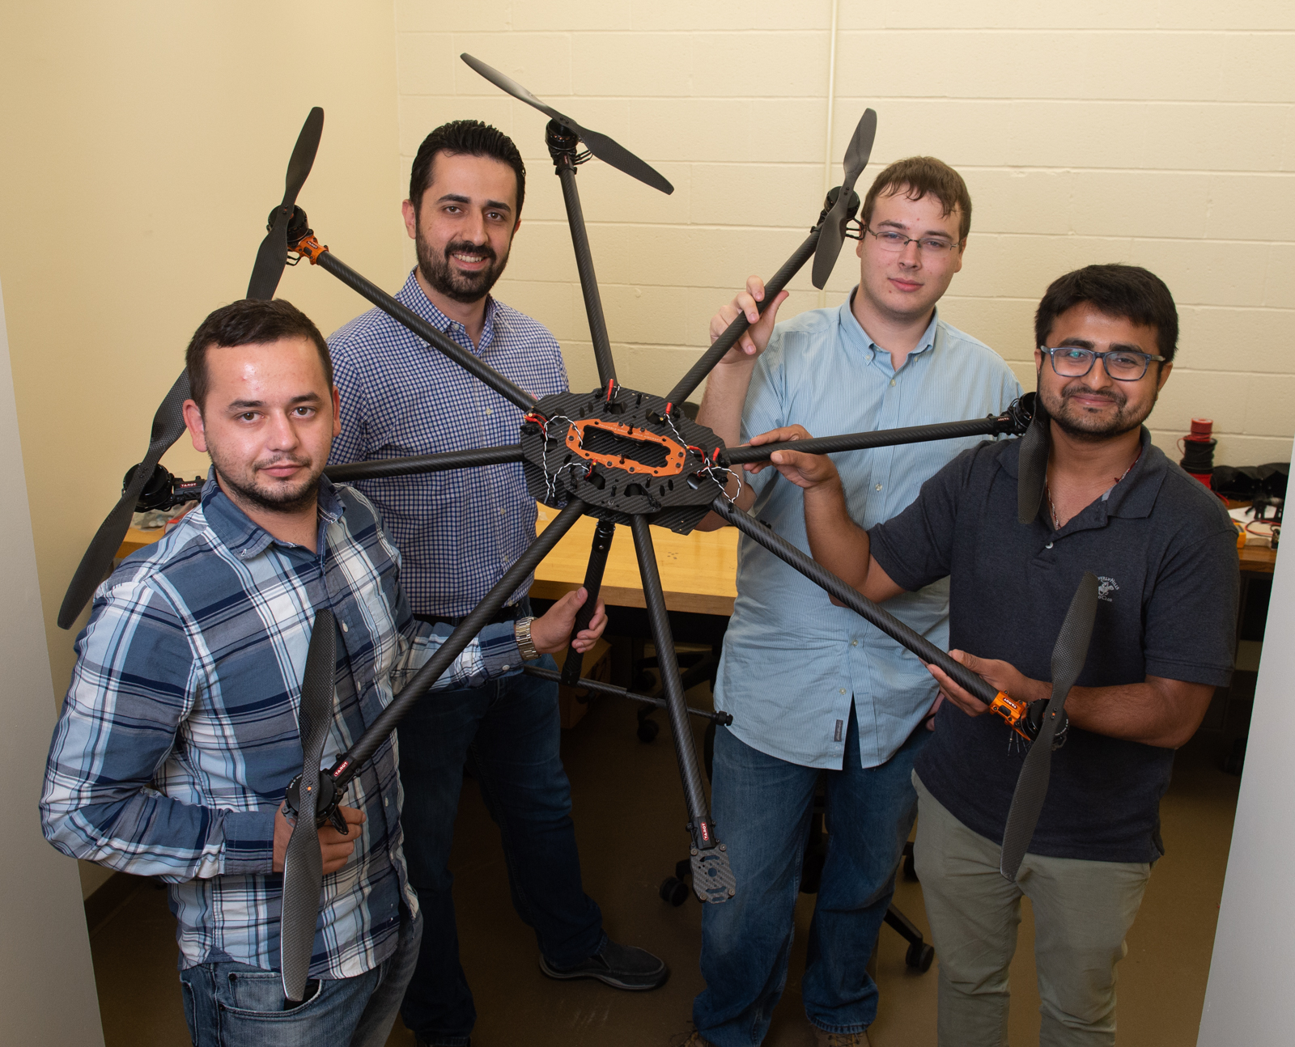
A little bit about me …
My name is Nima Lotfi
One of the founders of the FoMRE team
Assistant Professor in Mechanical and Mechatronics Engineering Department (08/16/2016 – present)
Research and teaching in
Mechatronics
Robotics
Controls
…
Student design teams:
Autonomous Robotics Club (ARC)
Drone Club of SIUE

Slide 3
Some of the discussion topics in the FoMRE workshops
What hardware and software platforms can best complement MRE courses?
What about open-source? What are their potentials and challenges?
…

Slide 4
We formed a working group and …
Lotfi, N., Berry, C., Rodriguez, L., Mbanisi, K., Auslander, D., Molki, M. (2020). Promoting Open-source Software and Hardware Platforms in Mechatronics and Robotics Engineering Education. Virtual: 2020 ASEE Annual Conference and Exposition.
Lotfi, N., Auslander, D., Rodriguez, L., Mbanisi, K., Berry, C. Use of Open-source Software Platforms in Mechatronics and Robotics Engineering Education – Part I: Model Simulation and Analysis. ASEE Computers in Education Journal. (Accepted/In-press)
Lotfi, N., Auslander, D., Rodriguez, L., Mbanisi, K., Berry, C. Use of Open-source Software Platforms in Mechatronics and Robotics Engineering Education – Part II: Controller Implementation. ASEE Computers in Education Journal. (Accepted/In-press)

Slide 5
Open-source way
The “open-source way”, initially used in software development, distribution and maintenance, was motivated by the need for
better collaboration amongst developers
improved accessibility
reliability of software through a network of contributors.
Open-source software (OSS) is defined as software released under a license which grants users the right to study, use, modify, and distribute the source code to anyone and for any purpose.

Slide 6
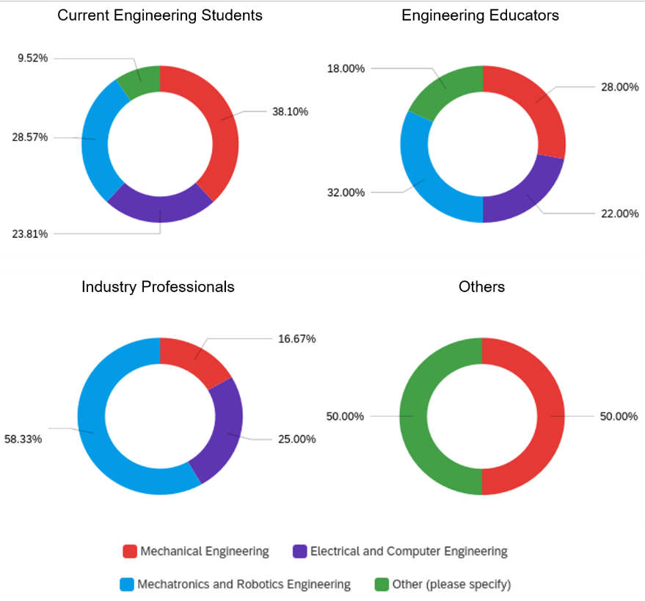
Community Impressions of the Open-source Software
Notes:
A recent survey conducted in order to understand the extent to which professionals in various engineering disciplines are familiar with and utilize the OSS.
A total of 131 responses were received from various stakeholders comprising of 55 current engineering students, 59 engineering educators, 14 industry professionals, and 2 Other (a mathematics and a retired professor).

Slide 7
Potentials of the OSS
No acquisition costs
Source code availability and customizability
Security, stability, and privacy
Acceptance as industry standard
Strengthened relationship between the user and the software
Accessibility for low-income and unprivileged society groups
Applicability to a wider range of projects
Speeding up the project due to the available libraries and online solutions
Cost and time savings for industry
Promoting and enabling innovation for a wider community
Promoting self-learning
Long-term accessibility, even after graduation
Incorporation of community feedback
Large number of online tutorials
No licensing hassles
Suitable for online education
Adaptability to certain applications
Potential to promote learning core skills
Lack of commercials and marketing noise
Avoiding subscription-based billing models
Plug and play design
Ease testing multiple methods without a high cost of integration
Lack of need for training new hires by the industry

Slide 8
Challenges of the OSS
Difficulties in initial installation, package additions, and setup
Where/how/what to learn for a specific application
Lack of official technical support and quality documentation
Lack of familiarity with proper online search towards troubleshooting specific problems
Technical documentation in non-English languages
Initial learning curve
Version compatibility and frequent updates
Reliability of the online information
Lack of practice exercises
Security of online forums and websites
Lack of maintenance
An OSS with Simulink capabilities
Lack of course specific material

Slide 9
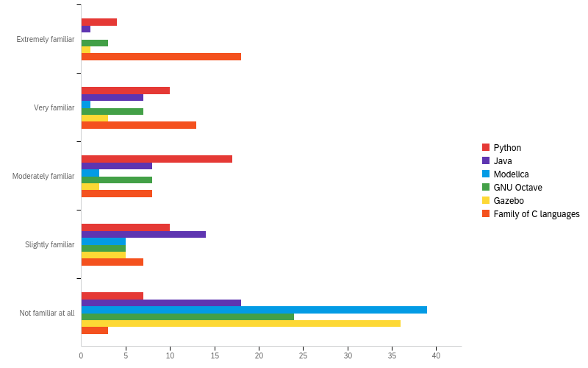
Level of proficiency with common open-source software (faculty)

Slide 10
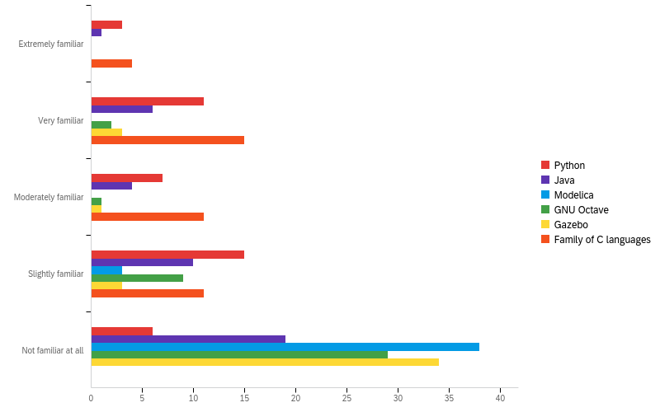
Level of proficiency with common open-source software (students)

Slide 11
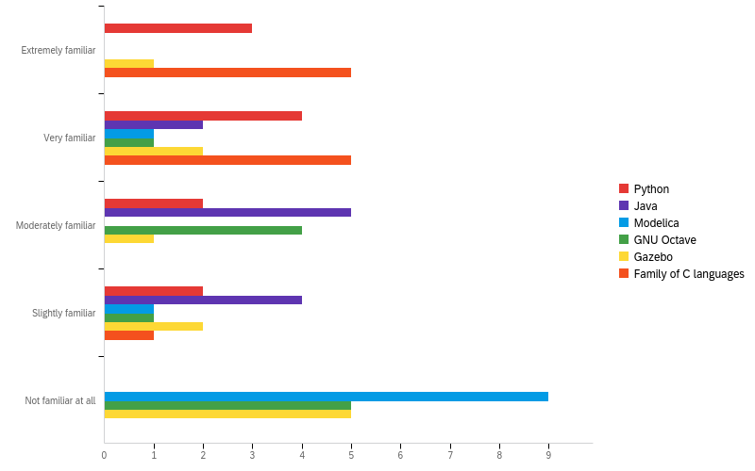
Level of proficiency with common open-source software (industry)

Slide 12
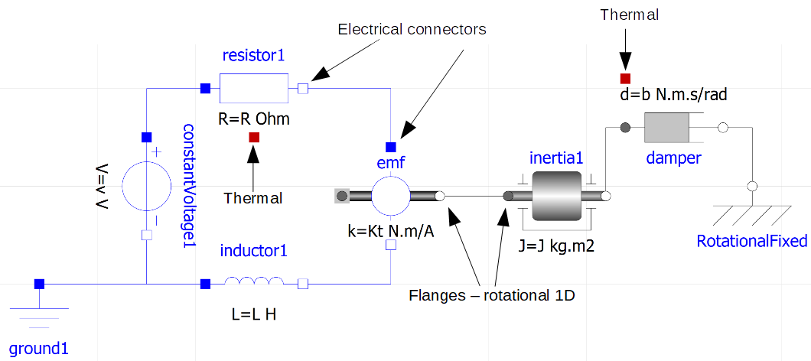
Other paper contributions
Considered two common MRE problems
DC motor model simulation and analysis
2 DOF robot manipulator control
Solved them using
Python
GNU Octave
Java
Modelica
Gazebo
Showed the code snippets in the paper
Shared the code scripts on Github

Slide 13
Open discussions
What platforms do you usually use in your classes?
Do you plan to use any open-source platforms in the future? Why/Why not?

